Slide 1

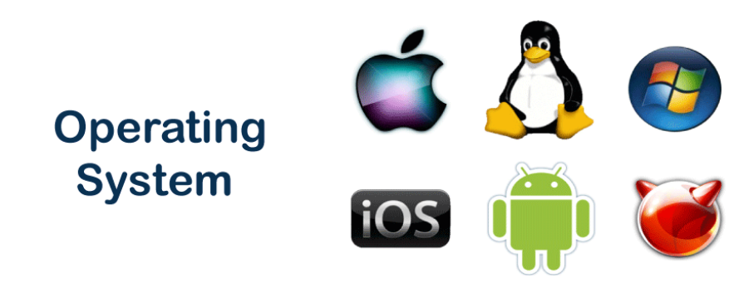
Information and Communication Technologies (ICT)
WEEK 4
TOPIC:
UNIX, LINUX, MAC, WINDOWS
USAGE OF OPERATING SYSTEM
FUNCTIONS OF OPERATING SYSTEM
OBJECTIVES OF OPERATING SYSTEM
FILE SYSTEM OF OPERATING SYSTEM
COMPONENT OF OPERATING SYSTEM

Slide 2
Operating System
Operating System(OS) is a set programs that manages the activities of the computer system
and lets the user use the system resources effectively.
An OS creates ability to:
• serve a variety of purposes
• interact with users in more complicated ways
• keep up with needs that change overtime
• management of the processor, RAM, I/O
• file and information Management
• management of execution of applications
Examples of OS are: Microsoft Windows, MAC OS, Ubuntu etc.

Slide 3
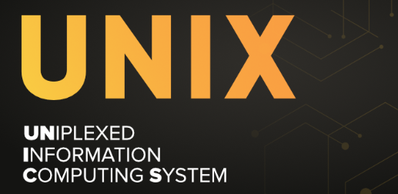
UNIX
Birth of UNIX:
In the late 1960s and early 1970s, Kenneth Thompson and Dennis Ritchie created a small computer system called UNIX.
UNIX's Superpowers:
UNIX was the first operating system of its kind.
It was used to make computers do all sorts of important tasks.
UNIX Grows Up
Over time, UNIX got even better when it was rewritten in a special computer language called C.

Slide 4
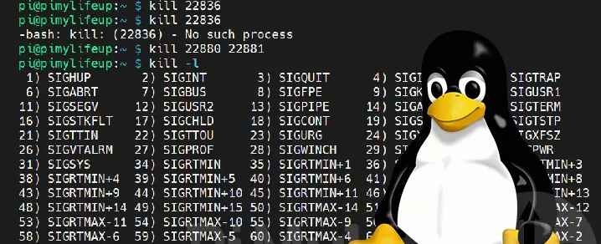
LINUX
Birth of Linux:
Inspired by UNIX
In 1991, a guy named Linus Torvalds made something called "Linux."
What Linux Does:
Linux is like a powerful engine for computers.
What Makes Linux Special:
Linux is free, like a free movie you can download from the internet.
Two Ways to Talk to Linux:
Friendly Talking (Graphical Way)
You can use buttons and pictures to talk to Linux, just like using a computer game.
Magic Talking (Terminal or BASH)
If you want to do really cool and secret stuff with Linux, you can use special secret code words. It's like having magic powers for your computer.
Why Magic Talking is Important:
Magic talking (Terminal or BASH) lets you do special things with the computer, especially if you want to be a computer wizard or a programmer.

Slide 5
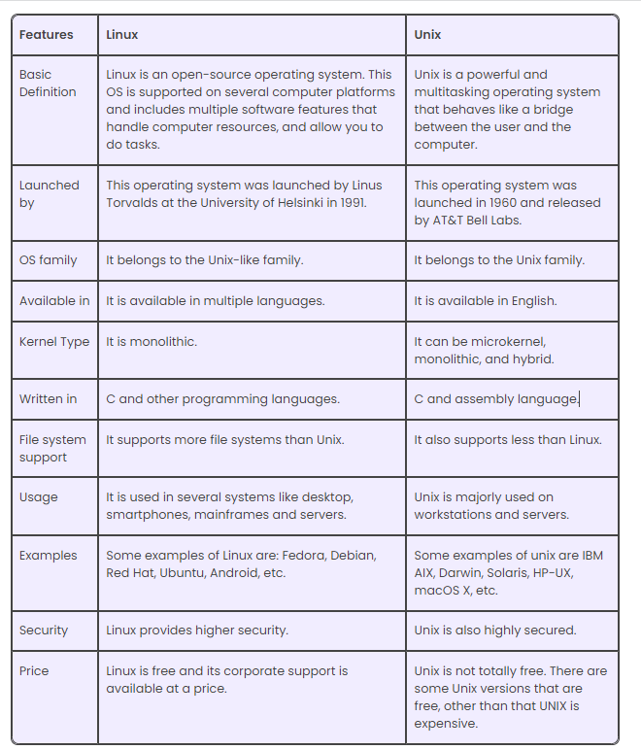
UNIX VS LINUX

Slide 6
WINDOWS
Birth of Windows:
In the year 1985, a tech giant named Microsoft introduced something groundbreaking called "Windows." It was an operating system designed to bring a graphical user interface to personal computers, inspired by the innovations of the time.
What Windows Does:
Windows is like a powerful engine for computers, driving their capabilities to new heights. It serves as the bridge between you and the machine, making complex tasks as simple as a click.
What Makes Windows Special:
Accessible to All
Two Ways to Interact with Windows:
Friendly Interaction (Graphical Way):
Windows provides a friendly interface where you can use buttons, icons, and pictures to communicate with your computer. It's as intuitive as playing a computer game, making computing an enjoyable experience for all.
Advanced Interaction (Command Line or PowerShell):
For those seeking to unlock the full potential of Windows, there's an advanced way to communicate—using command lines or PowerShell. It's like having access to a set of secret code words that bestow you with unique powers, giving you control over your computer like a wizard.
Why Advanced Interaction Matters:
Advanced interaction methods, like the Command Line or PowerShell, empower you to perform specialized tasks. If you aspire to be a computer wizard or a programmer, these tools become your magic wand, allowing you to harness the full potential of your computer.

Slide 7
MAC
Birth of macOS:
In the early 1980s, a group of visionaries at Apple set out to create an operating system that would revolutionize personal computing. This vision gave birth to macOS, a masterpiece of innovation and design.
What macOS Does:
macOS is not just an operating system; it's an embodiment of art and technology. It powers Apple's Mac computers, offering a platform where beauty and functionality coexist harmoniously.
What Makes macOS Special:
One of the defining features of macOS is its simplicity. It's designed to make complex tasks feel effortless. With macOS, technology fades into the background, allowing you to focus on what truly matters.
Two Ways to Interact with macOS:
User-Friendly Interface:
macOS provides a user-friendly interface adorned with elegant icons and a sleek design. Interacting with your Mac is like navigating a work of art, where every detail is meticulously crafted for your pleasure.
Terminal:
For those who seek the power of the command line, macOS offers the Terminal. It's a gateway to a world of possibilities, where you can execute commands and perform tasks with precision.
Why the Terminal Matters:
The Terminal in macOS empowers you to take control. Whether you're a developer, a system administrator, or simply someone who enjoys the art of coding, the Terminal is your canvas for creating digital masterpieces.

Slide 8
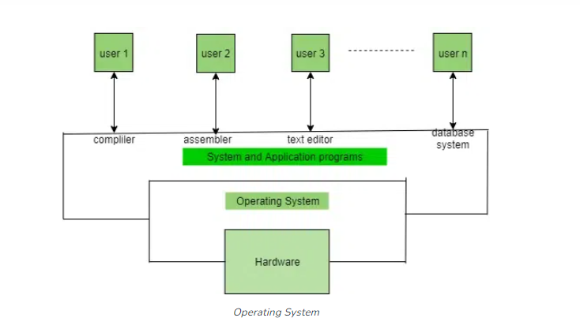
Why Use an Operating System?
An operating system (OS) is like a helpful middleman for your computer. It makes your computer easier to use and connects your software and hardware. It's important for every device because it lets your apps talk to your computer's parts without needing to know all the technical details. Think of it as the glue that holds everything together, making your device work smoothly.

Slide 9
Functions of the Operating System
Resource Management: The operating system manages and allocates memory, CPU time, and other hardware resources among the various programs and processes running on the computer.
Process Management: The operating system is responsible for starting, stopping, and managing processes and programs. It also controls the scheduling of processes and allocates resources to them.
Memory Management: The operating system manages the computer’s primary memory and provides mechanisms for optimizing memory usage.
Security: The operating system provides a secure environment for the user, applications, and data by implementing security policies and mechanisms such as access controls and encryption.
Job Accounting: It keeps track of time and resources used by various jobs or users.
File Management: The operating system is responsible for organizing and managing the file system, including the creation, deletion, and manipulation of files and directories.
Device Management: The operating system manages input/output devices such as printers, keyboards, mice, and displays. It provides the necessary drivers and interfaces to enable communication between the devices and the computer.
Networking: The operating system provides networking capabilities such as establishing and managing network connections, handling network protocols, and sharing resources such as printers and files over a network.
User Interface: The operating system provides a user interface that enables users to interact with the computer system. This can be a Graphical User Interface (GUI), a Command-Line Interface (CLI), or a combination of both.
Backup and Recovery: The operating system provides mechanisms for backing up data and recovering it in case of system failures, errors, or disasters.
Virtualization: The operating system provides virtualization capabilities that allow multiple operating systems or applications to run on a single physical machine. This can enable efficient use of resources and flexibility in managing workloads.
Performance Monitoring: The operating system provides tools for monitoring and optimizing system performance, including identifying bottlenecks, optimizing resource usage, and analyzing system logs and metrics.
Time-Sharing: The operating system enables multiple users to share a computer system and its resources simultaneously by providing time-sharing mechanisms that allocate resources fairly and efficiently.
System Calls: The operating system provides a set of system calls that enable applications to interact with the operating system and access its resources. System calls provide a standardized interface between applications and the operating system, enabling portability and compatibility across different hardware and software platforms.
Error-detecting Aids: These contain methods that include the production of dumps, traces, error messages, and other debugging and error-detecting methods.

Slide 10
Objectives of Operating Systems
Convenient to use: One of the objectives is to make the computer system more convenient to use in an efficient manner.
User Friendly: To make the computer system more interactive with a more convenient interface for the users.
Easy Access: To provide easy access to users for using resources by acting as an intermediary between the hardware and its users.
Management of Resources: For managing the resources of a computer in a better and faster way.
Controls and Monitoring: By keeping track of who is using which resource, granting resource requests, and mediating conflicting requests from different programs and users.
Fair Sharing of Resources: Providing efficient and fair sharing of resources between the users and programs.

Slide 11
How To Choose the Correct Operating System?
Price Factor: Price is one of the factors to choose the correct Operating System as there are some OS that is free, like Linux, but there is some more OS that is paid like Windows and macOS.
Accessibility Factor: Some Operating Systems are easy to use like macOS and iOS, but some OS are a little bit complex to understand like Linux. So, you must choose the Operating System in which you are more accessible.
Compatibility factor: Some Operating Systems support very less applications whereas some Operating Systems supports more application. You must choose the OS, which supports the applications which are required by you.
Security Factor: The security Factor is also a factor in choosing the correct OS, as macOS provide some additional security while Windows has little fewer security features.

Slide 12
Examples of Operating Systems
Windows (GUI-based, PC)
Linux (Personal, Workstations, ISP, File, and print server, Three-tier client/Server)
macOS (Macintosh), used for Apple’s personal computers and workstations (MacBook, iMac).
Android (Google’s Operating System for smartphones/tablets/smartwatches)
iOS (Apple’s OS for iPhone, iPad, and iPod Touch)

Slide 13
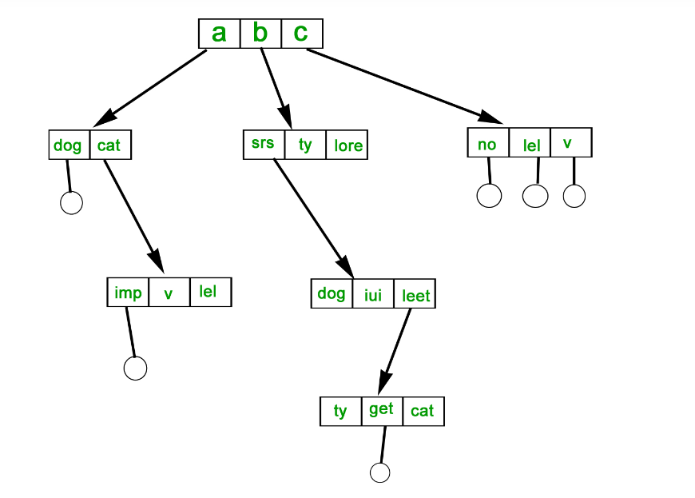
File Systems in Operating System
Organization: A file system allows files to be organized into directories and subdirectories, making it easier to manage and locate files.
Data protection: File systems often include features such as file and folder permissions, backup and restore, and error detection and correction, to protect data from loss or corruption.
Improved performance: A well-designed file system can improve the performance of reading and writing data by organizing it efficiently on disk.

Slide 14
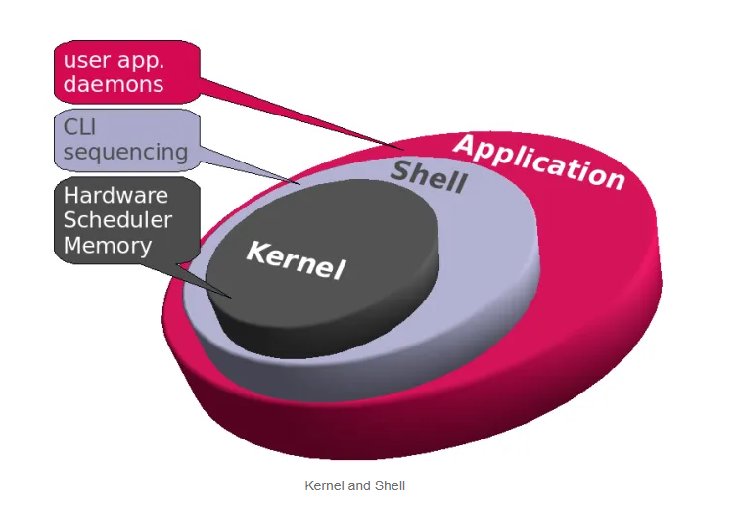
Components of an Operating Systems
Shell
Shell is the outermost layer of the Operating System and it handles the interaction with the user. The main task of the Shell is the management of interaction between the User and OS. Shell provides better communication with the user and the Operating System Shell does it by giving proper input to the user it also interprets input for the OS and handles the output from the OS. It works as a way of communication between the User and the OS.
Kernel
The kernel is one of the components of the Operating System which works as a core component. The rest of the components depends on Kernel for the supply of the important services that are provided by the Operating System. The kernel is the primary interface between the Operating system and Hardware.

Slide 15
Advantages & Disadvantages of Operating System
ADVANTAGES | DISADVANTAGES
User-Friendly Interface: Operating systems provide a user-friendly interface, making computers accessible to a wide range of users, regardless of their technical expertise. This ease of use enhances productivity and enables more people to benefit from computer technology. | Complexity: Operating systems can be complex and may require technical expertise to manage and troubleshoot effectively. This complexity can pose challenges for both users and administrators, particularly when dealing with advanced configurations or troubleshooting issues.
Resource Management: Operating systems efficiently manage computer resources such as CPU, memory, and storage, ensuring that these resources are used optimally. This resource management is crucial for the smooth and efficient operation of computer systems, allowing multiple applications to run simultaneously without conflicts. | Resource Overhead: Operating systems consume system resources themselves, which can lead to a reduction in overall system performance and efficiency. This resource overhead can limit the available resources for running applications.

